Slide 1
Machine Learning
German credit score & NYC Taxi Fare Prediction

Slide 2
Regression - NYC Taxi fare

Slide 3
Executive Summary
10.44
9.77
Random Forest
CV MAPE
Test MAPE
Best Model?

Slide 4
Used Variables
Initial Variables
Final Variables
dropoff_latitude
dropoff_longitude
fare_amount
features from feat01 to feat10
key
passenger_count
pickup_datetime
pickup_latitude
pickup_longitude
dropoff_latitude
dropoff_longitude
fare_amount
features from feat01 to feat10
passenger_count
pickup_latitude
pickup_longitude
zero_indicator
straight_dist
count
hour4
hour5
hour19
hour20

Slide 5
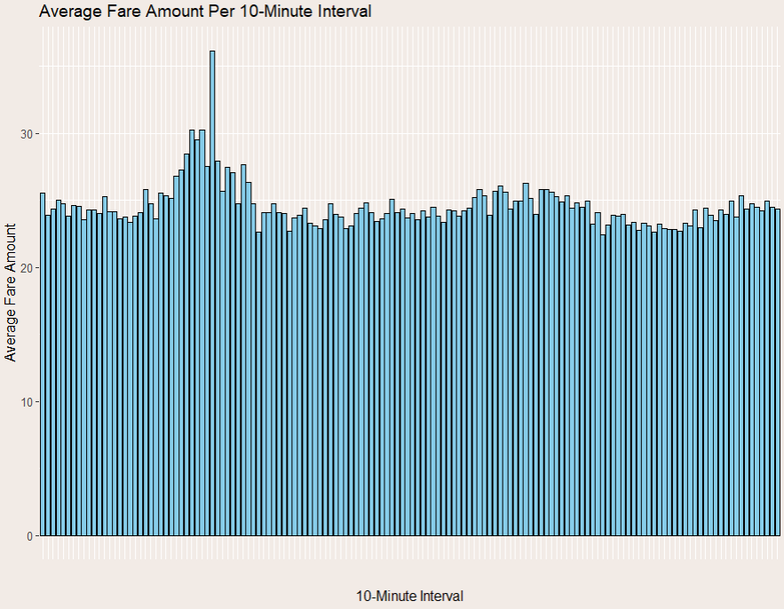
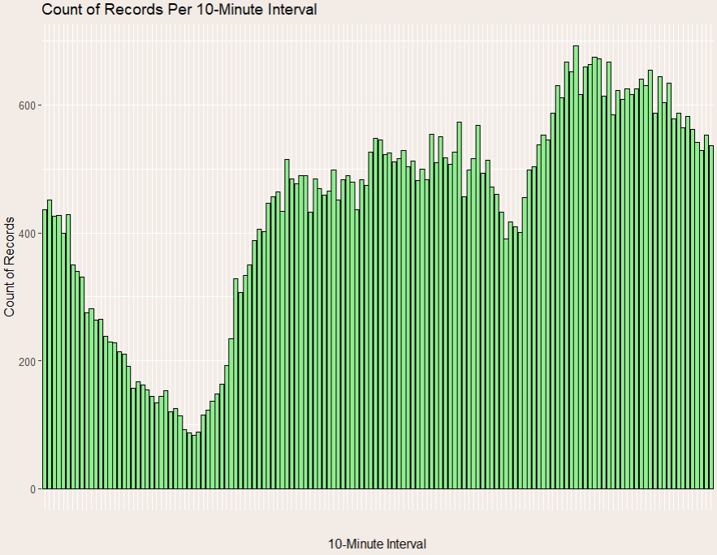
Feature Exploratory Data Analysis
Time dependancy

Slide 6
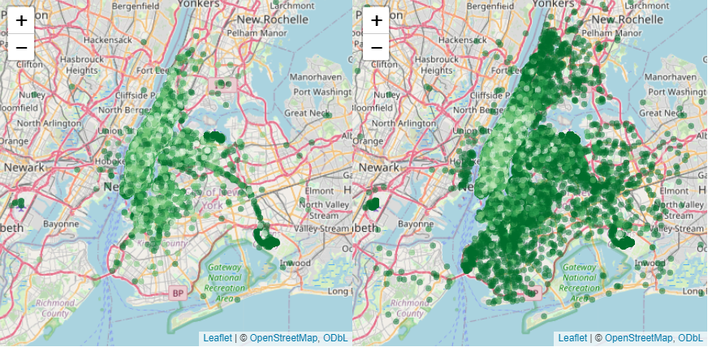
Feature Exploratory Data Analysis
Pickup localization
Dropoff localization

Slide 7
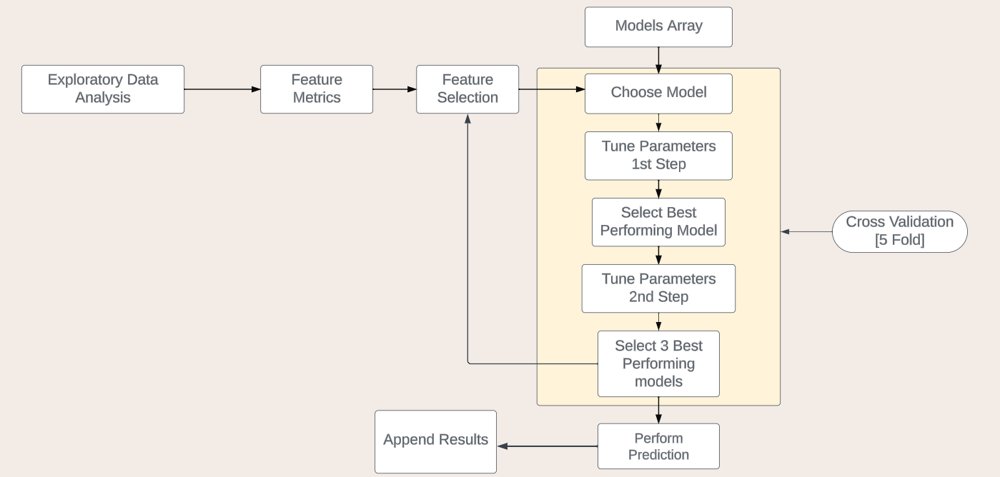
Model of dataflow

Slide 8
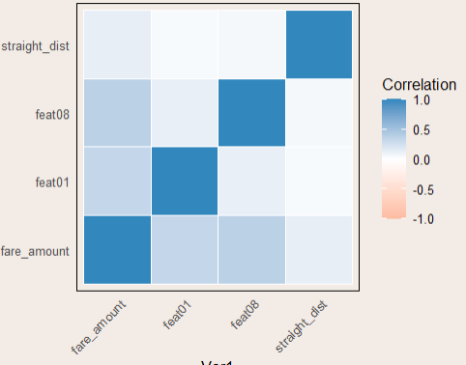
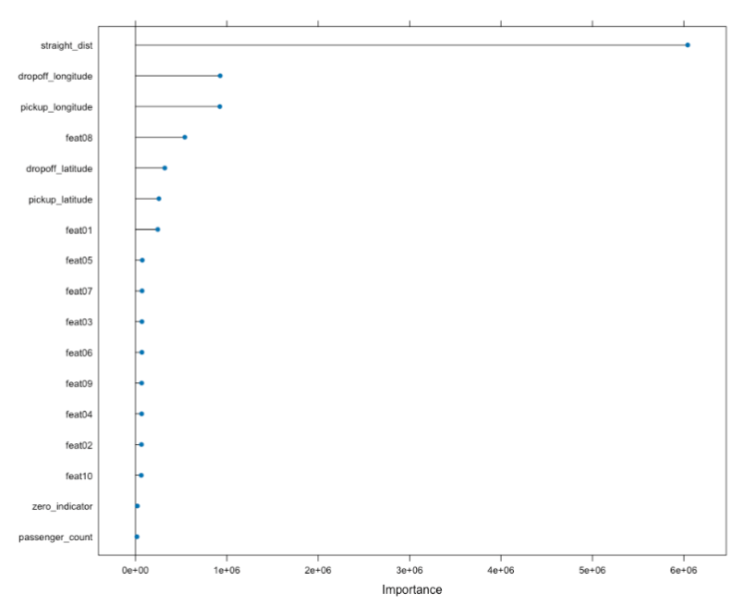
Feature Selection
1
3
Mutual Information
All Values
2
Correlation
4
Importance Score

Slide 9
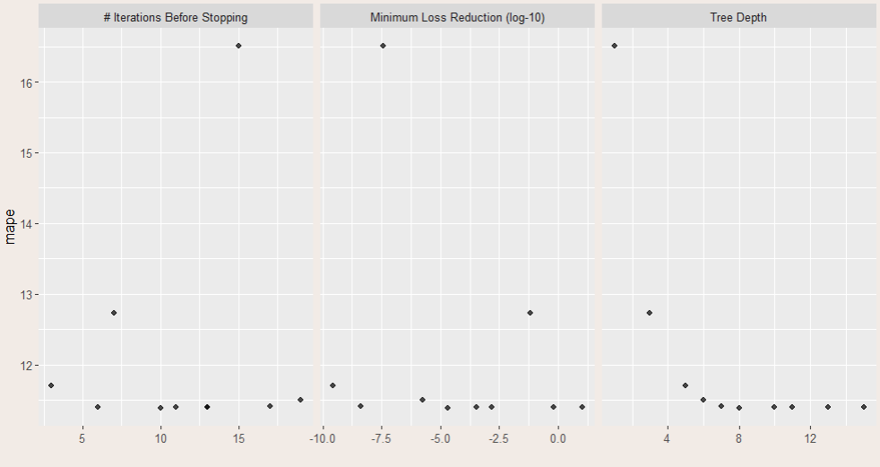
LGBM Tuning

Slide 10
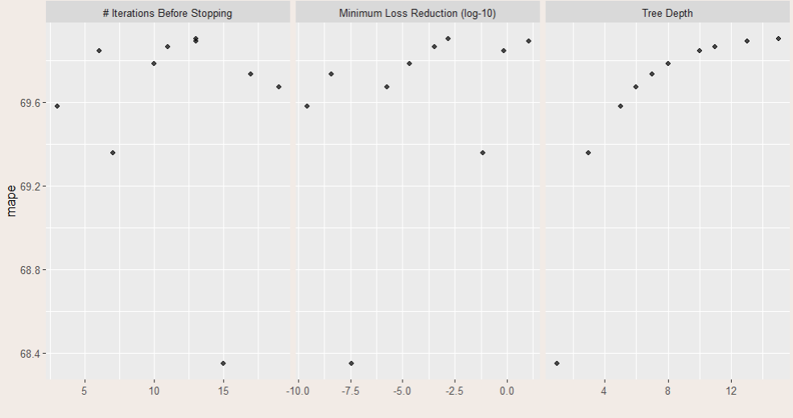
XGBoost Tuning

Slide 11
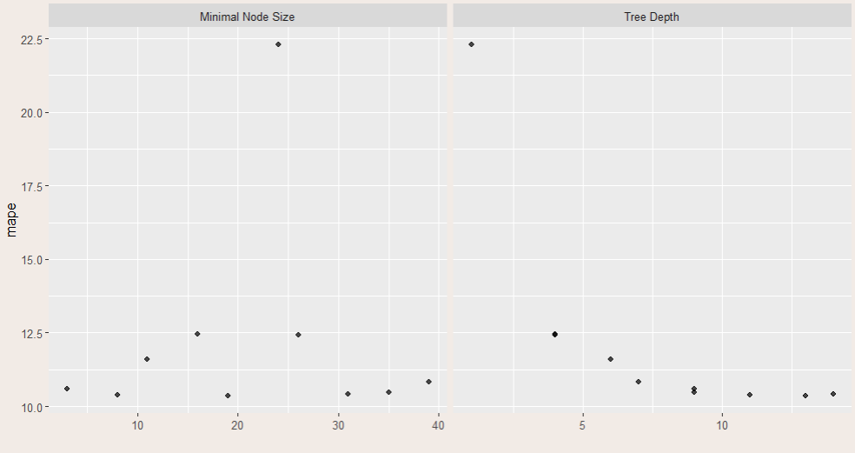
Decision Tree Tuning

Slide 12
Results
Iteration | Mape_Train | Mape_test | models_spec | model_name
3 | 10,40 | 9,77 | trees = 853, min_n = 9, mtry = 6 | random_forest
1 | 10,37 | 9,77 | trees = 853, min_n = 5, mtry = 6 | random_forest
2 | 10,37 | 9,78 | trees = 853, min_n = 15, mtry = 6 | random_forest
2 | 10,37 | 10,58 | min_n = 8, tree_depth = 11, cost_complexity = 0 | decision_tree
1 | 10,37 | 10,84 | min_n = 19, tree_depth = 13, cost_complexity = 0 | decision_tree
3 | 10,40 | 10,94 | min_n = 31, tree_depth = 14, cost_complexity = 0 | decision_tree
1 | 12,33 | 11,48 | learn_rate = 0.02, tree_depth = 8, loss_reduction = 0.97, stop_iter = 18 | lgbm
2 | 12,34 | 11,52 | learn_rate = 0.02, tree_depth = 9, loss_reduction = 0, stop_iter = 19 | lgbm
3 | 12,34 | 11,56 | learn_rate = 0.02, tree_depth = 11, loss_reduction = 0, stop_iter = 7 | lgbm
1 | 68,35 | 70,94 | learn_rate = 0.02, tree_depth = 2, loss_reduction = 0.01, stop_iter = 11 | xgboost
2 | 69,36 | 71,11 | learn_rate = 0.02, tree_depth = 3, loss_reduction = 0.02, stop_iter = 9 | xgboost
3 | 69,58 | 71,27 | learn_rate = 0.02, tree_depth = 5, loss_reduction = 0, stop_iter = 5 | xgboost

Slide 13
Classification problem

Slide 14
Executive Summary
92.1%
77%
XGB
CV GINI
Test GINI
Best Model?

Slide 15
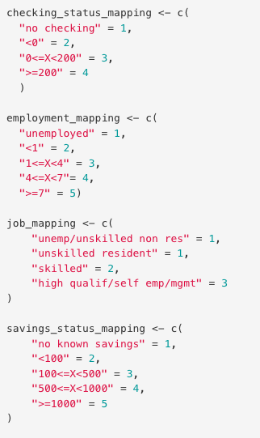
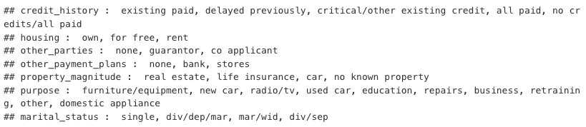
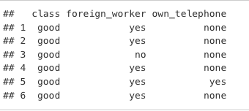
Data cleaning
Missing values - no missing values
Personal status column (female div/dep/mar, male div/sep, male mar/wid, male single) - divided into 2 columns: sex, marital_status
Ordered categorical variables - as on the picture
Boolean variables
One hot-encoding applied to all categorical variables (remove_first_dummy = TRUE)
Finally we finished data cleaning process with 51 variables (including id)
explained variable: bad: 30%, good: 70%

Slide 16
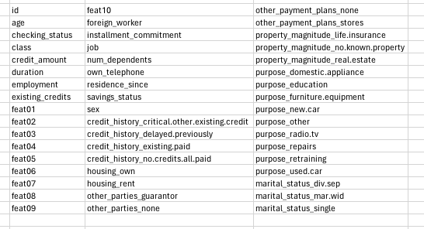
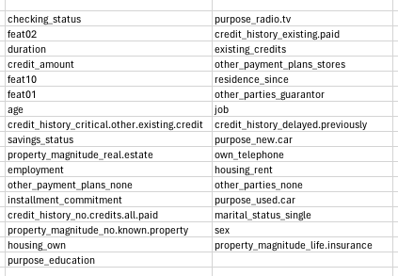
Recursive feature elimination
50 variables (without class)
33 final predictors

Slide 17
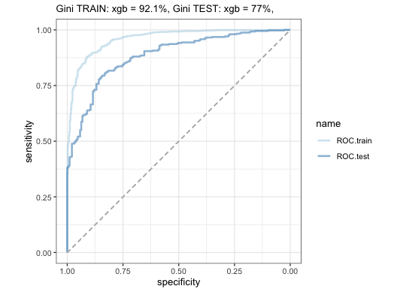
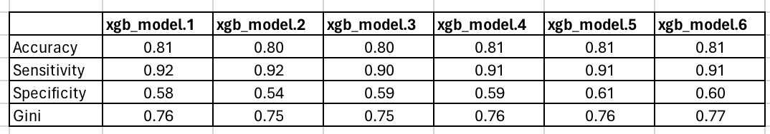
XGB - one by one
colsample_bytree - rule of thumb(number of predictors - sqrt(35)/35 (0.17)
min_child_weight - 0.5 - 1% of num of obs (10–20)
The order of tuning parameters:
nrounds - 40
max_depth, min_child_weight (5, 12)
colsample_bytree - 0.65
subsample - 0.85
double nrounds, reduce by half learning rate (80, 0.12)
double nrounds, reduce by half learning rate (160, 0.06)
The last model was the best - we choose this one
GINI train: 92.1%
GINI test: 77%

Slide 18

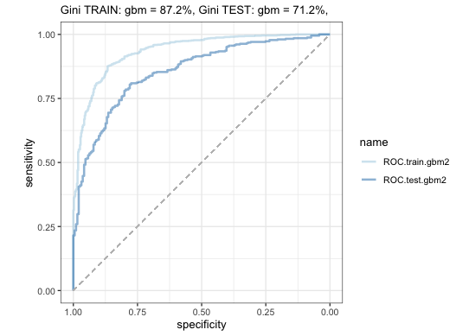

GBM
Hyperparameter tuning - the best for this model
n.trees = 500
interaction.depth = 4
shrinkage = 0.1
n.minobsinnode = 150
GINI train: 84.3%
GINI test: 74.8%

Slide 19
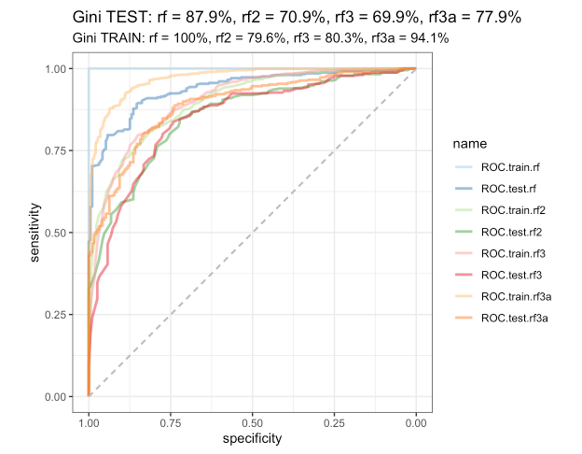
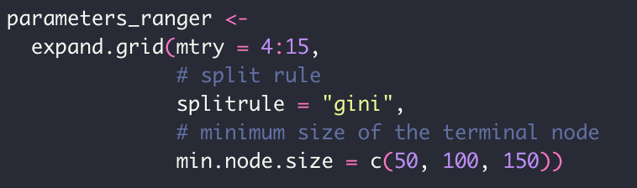
Random Forest
Models with and without cv
Hyperparameter tuning - the best for this model:
mtry = 6
min.node.size = 50
GINI train: 94.1%
GINI test: 77.9%

Slide 20
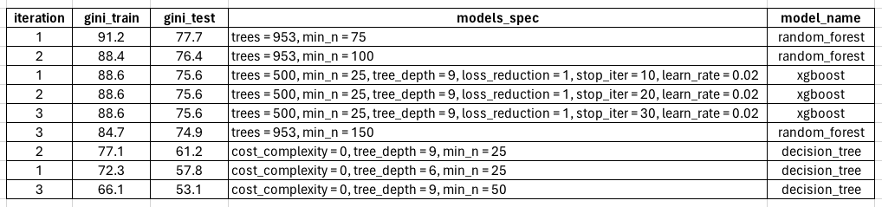
Results

Slide 21
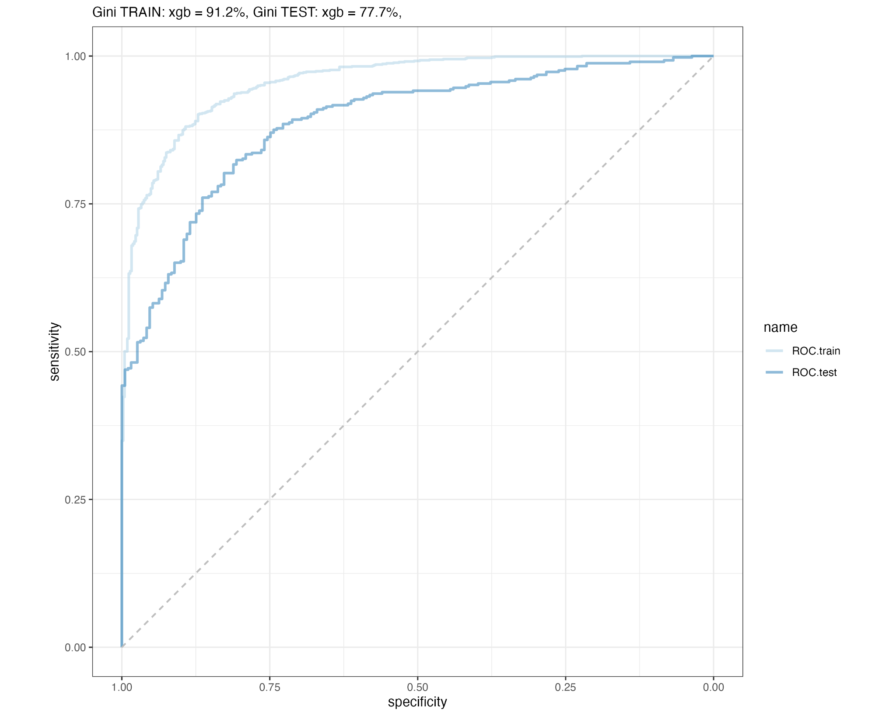
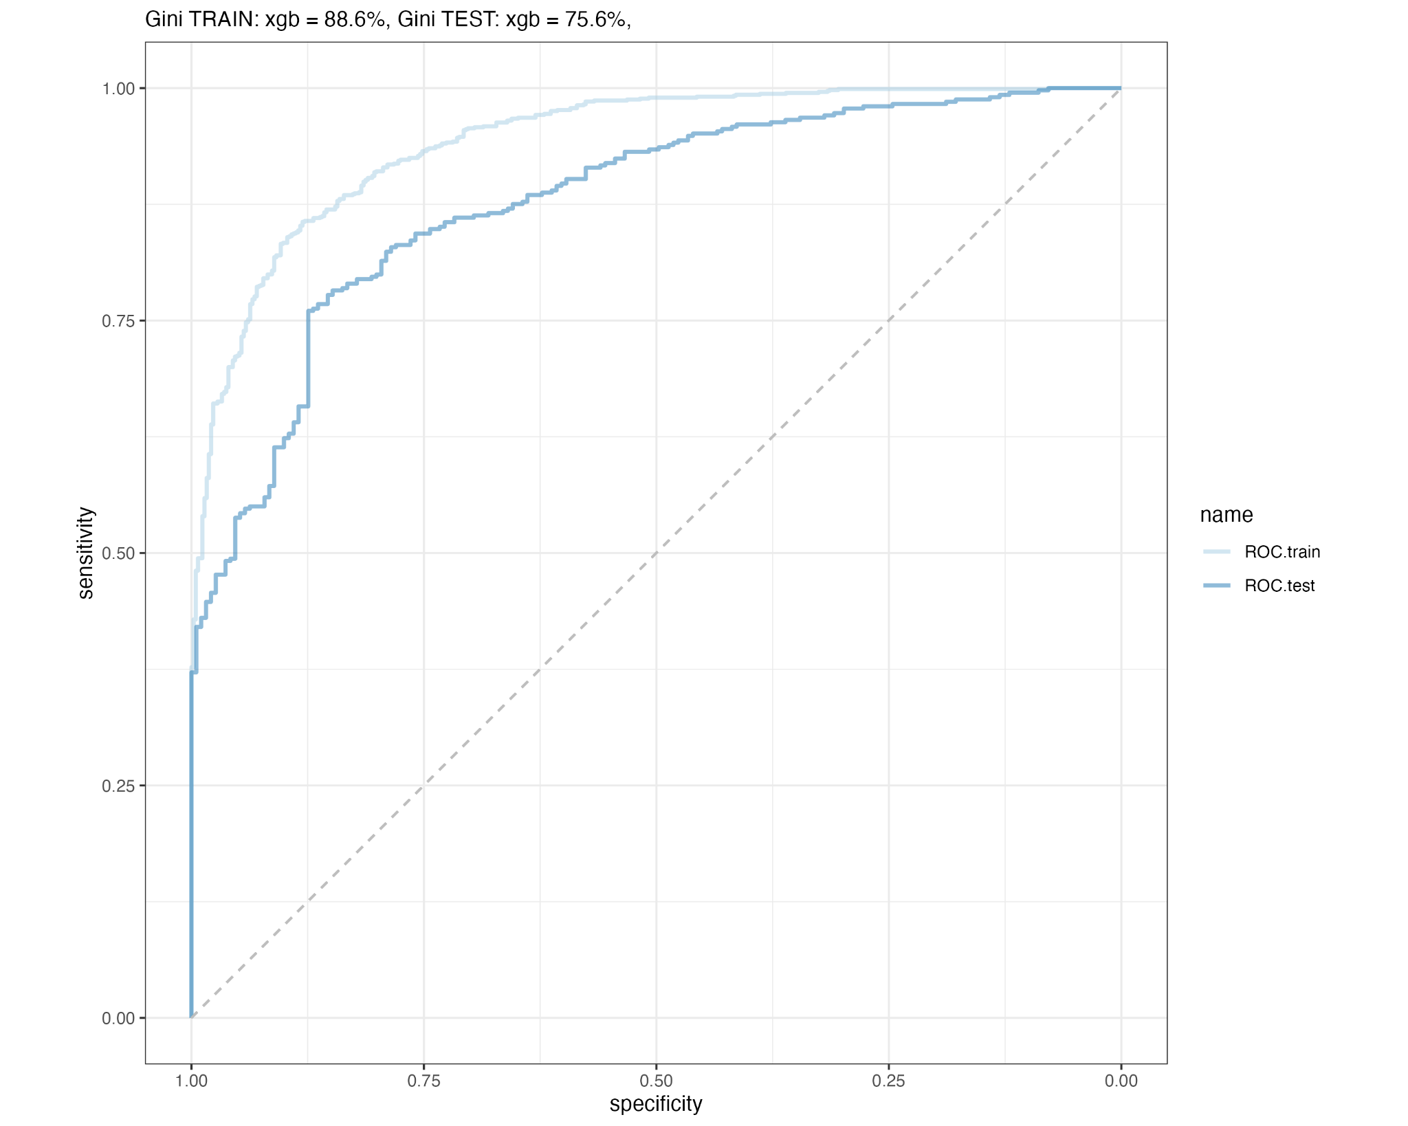
ROC for selected models from table
random forest, iteration 1
xgb, iteration 2
rf

